Slide 1
Predicting School Dropouts
Cristina Mulas

Slide 2
Introduction
The goal of this project is to be able to predict whether or not students will successfully complete an educational course.
The data schema is about general academics and student demographics from Open University in the UK.
The dataset contains data from students who took seven courses over a period of two-years from 2013–2014.

Slide 3
Who Are My Students?

Slide 4
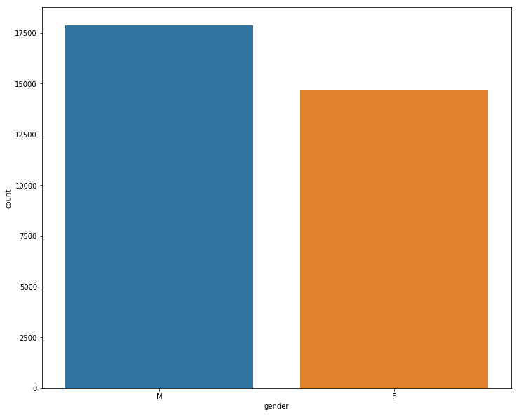
Gender
Notes:
In terms of gender, my data is pretty even.

Slide 5
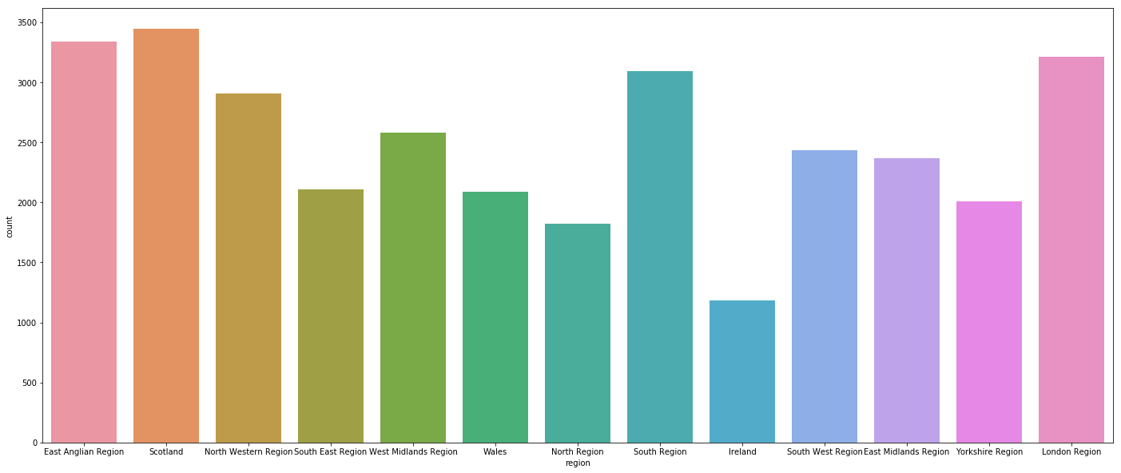
Region
Notes:
Most of my students are from Scotland and London Region

Slide 6
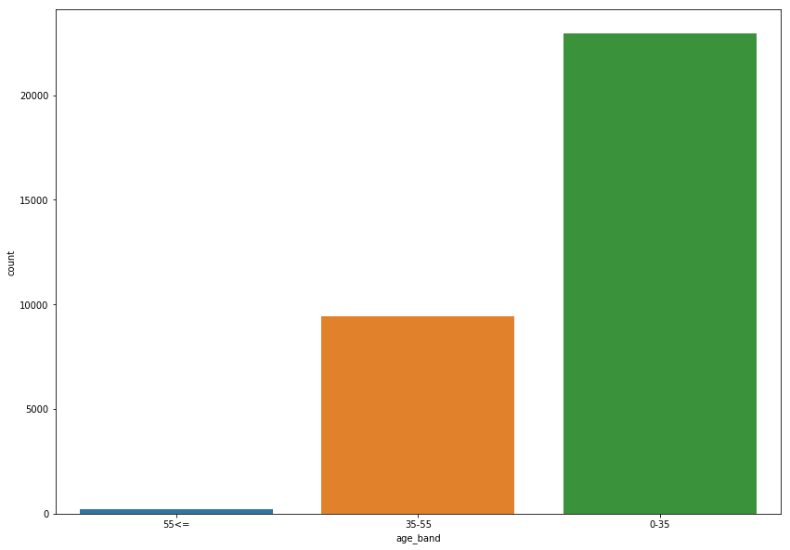
Age
Notes:
They are under 35 years old

Slide 7
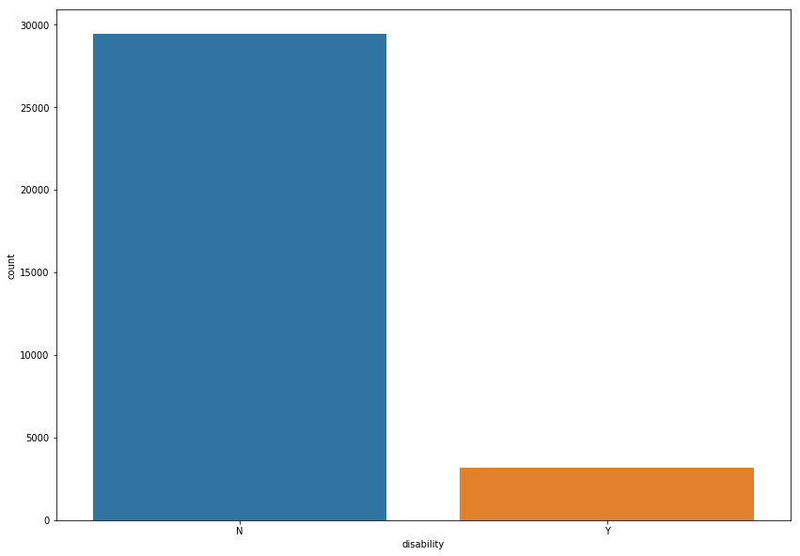
Disabilities
Notes:
I didnt see much students with Disabilities

Slide 8
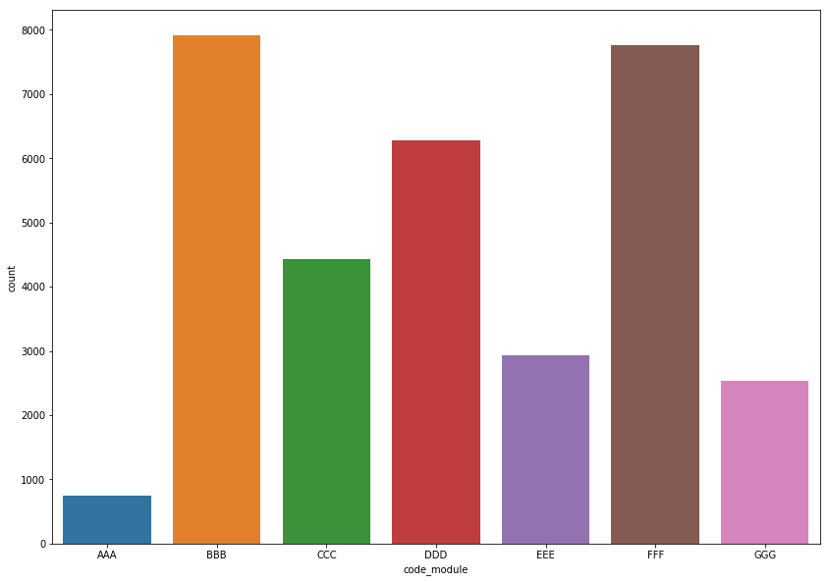
Courses
Notes:
Most of the studentes enrrol in BBB and FFF courses

Slide 9
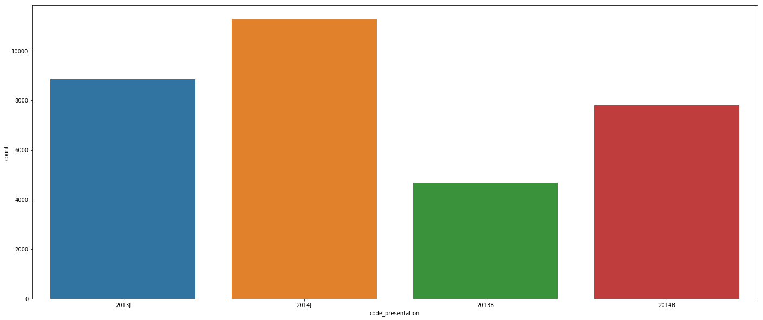
Semesters
Notes:
Enrollments through the semesters are pretty even witrh the exception of 2013

Slide 10
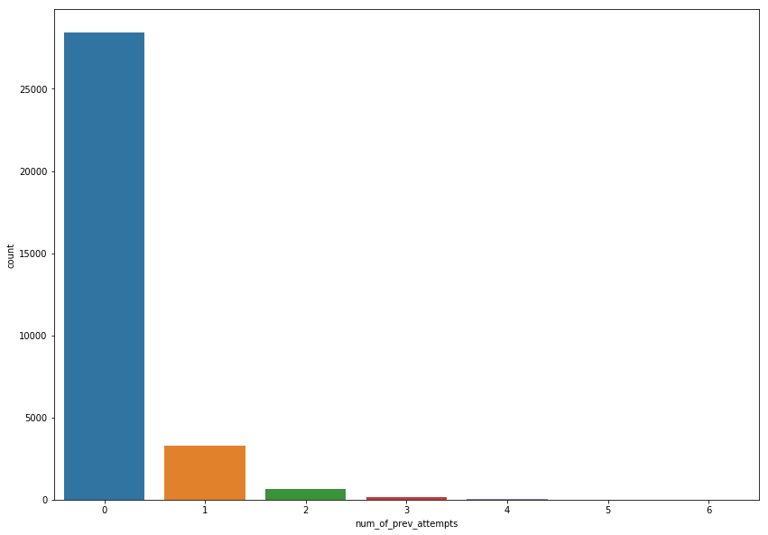
Previous Attempts
Notes:
From the data, the bigger numbers of my students didnt have previous Attempts in the courses

Slide 11
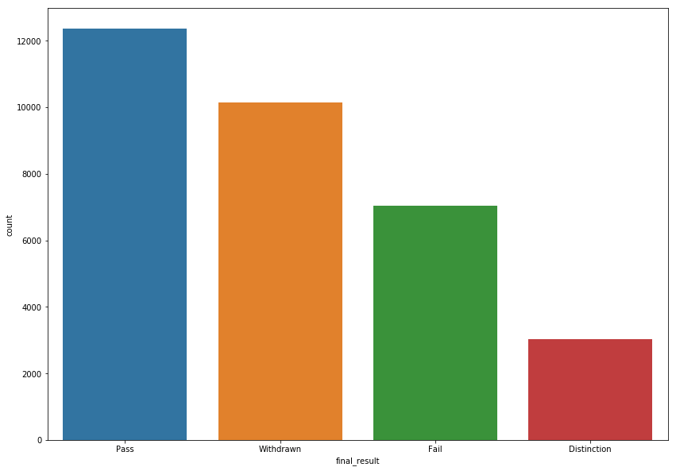
Final Result (Target Value)
Notes:
Most of the students pass the course.

Slide 12
The classifiers tested were:
Logistic Regression
Random Forest
Decision Tree
K-Nearest Neighbors
Gradient Boosting
SVC

Slide 13
Best Score
Logistic Regression 69 % accuracy ( 69% of students were correctly identificated)
Logistic Regression provides a true positive rate of 69%.
This means that about 69% of the students who will actually pass are predicted to do so by the model.

Slide 14
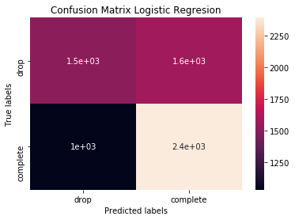
Logistic Regression Confusion Matrix
Notes:
[1516 1579]
[1035 2389]]

Slide 15
Future Work
Include more features.
Find data from other countries.

Slide 16
QUESTIONS?
Notes:
array([[1641, 1454],
[1054, 2370]])

